Slide 1
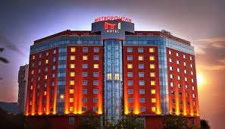
HOTEL BOOKING ANALYSIS
Team Data Digger
Team Members
Tejas Patil
Kailash sing
Riya Goyal
Samrudhhi Parihar
Rupesh Bherane
Capstone project year 2022

Slide 2
Points Of Discussion
Data Summary
Total Population Proportion
Best time to book a room in hotel
Proﬁtability of market different market segment Calculating probability of
special request
Which nationalities customer visit most
Which days customer prefer to stay in hotel
Percentage of Cancellation in resort and city hotel
Time series Analysis on most lucrative market segment
What type of meal customers prefer
How many customer require car parking space
predicting whether a hotel receive a disproportionately high number of special requests
How many customers are repeated
Demand based on the market segment
Number of arrivals in the year
Total bookings cancelled in the year
Co-relation of the column

Slide 3
DATA SUMMARY
hotel_booking_df : This pandas DataFrame contains and read whole data given in CSV so we can use it like spreadsheet
Proportion variable : this variable refer to the ﬁltered DataFrame of hotel_booking_df ﬁltered according to the adults ,children and babies
Hotel_Booking_year1:this variable binds to the DataFrame which contain information of years and booking months
city_hotel_market_segment:this variable contains information about market segment related to city hotel
resort_hotel_market_segment:this variable contains information about market segment related to resort hotel

Slide 4
special_request_count: contains information of total special request demanded from customer
Special_request_probability:contains DataFrame which contain probability of getting special request for city hotel and resort hotel
country_wise:this variable binds and contain country wise distribution of customers
Function total_stay: A python function for calculating total stay of customers
ﬁltered_df : this pandas DataFrame object contains information about hotel,arrival date month and market segment and used for time series plotting for showing time to time variation of most lucrative market segment

Slide 5
1.Total Population proportion
We will analyse entire data and divide the customers in three categories adults ,children and babies and will give the answers to following questions
What is the total number of adults in our data? What is the total number of children in our data? What is the total number of babies in our data?
What is the percentage of adults in our data? What is the percentage of children in our data? What is the percentage of babies in our data?

Slide 6
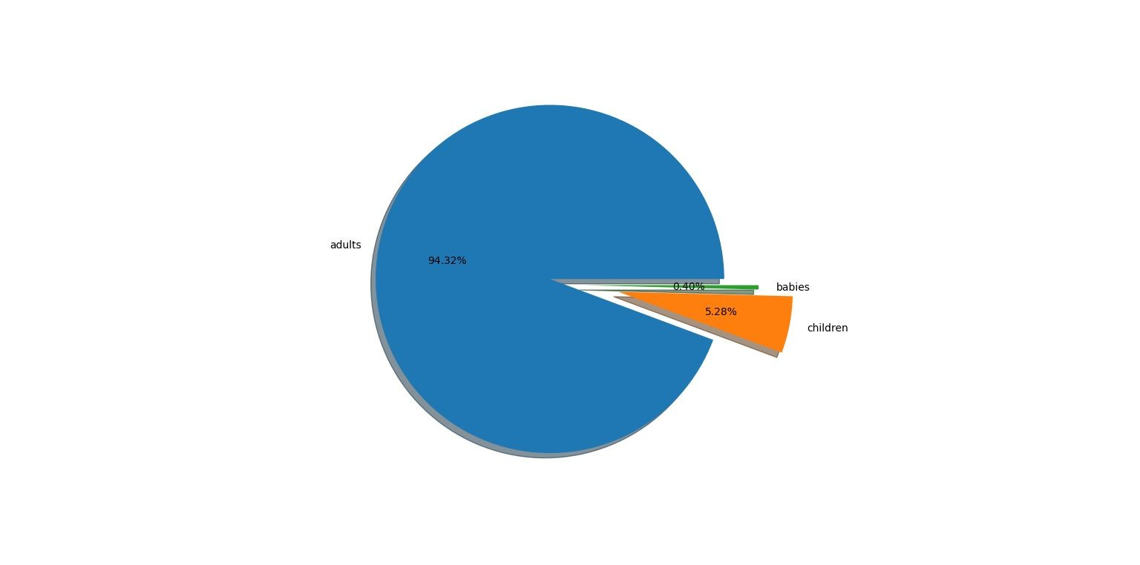
Pie chart showing percentage of adults ,children and babies

Slide 7
Total adults in data are 221636 Total children in data are 12403 Total babies in data are 949
Percentage of adults is maximum is data occupying whooping 94.32%
Percentage of childrens 5.28% Percentage of babies 0.40%

Slide 8
2.Best time to book a room in hotel
In this particular problem we have made our analysis on the basis of trafﬁc variation in different months of year after going through this slides you will come to know
Number of hotel bookings done in particular months of speciﬁc year
And therby we can conclude best time to book hotel

Slide 9
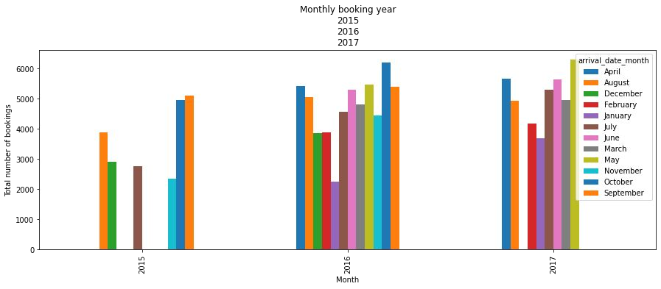
Graphical representation of trafﬁc on yearly as well as monthly basis
From above Graph we can say in the year 2015 month of august has received high trafﬁc and year 2016 month of April got tremendous demand of rooms in hotel and year 2017’s month may has received most trafﬁc in year 2017

Slide 10
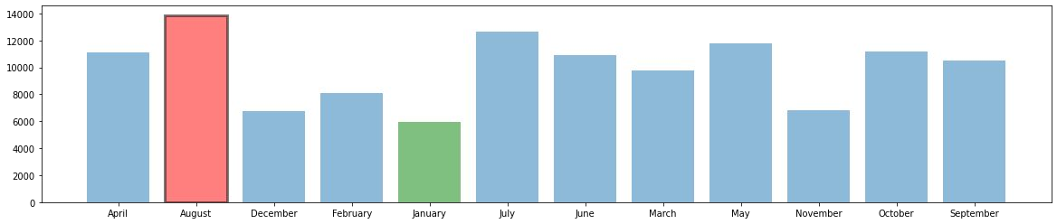
Conclusion
Thus we can conclude from above two graphs month of august on an average basis is the month who has got most trafﬁc and January month on an average has received least trafﬁc
So, we can say month of January is the best time to book a room in hotel

Slide 11
3.Which Market segment is most profitable (ADR)
perhaps we would like to see the revenue generated by each market segment by looking at the Average Daily Rate (ADR).
Average Daily Rate as defined by dividing the sum of all
lodging transactions by the total number of staying nights.
Therefore, the higher ADR means more revenue generated for each
staying night.
By getting insight of ADR we will be able to target a particular customer base for our advertising purposes also

Slide 12
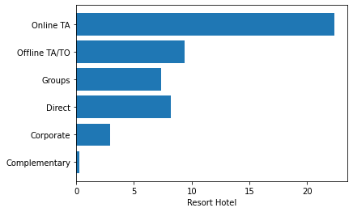
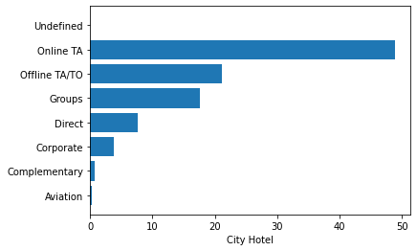
CALCULATING ADR
ADR for resort hotels
ADR for city hotels

Slide 13
CONCLUSION
Total ADR generated from online travel agent is the highest both
in the city hotel and the resort hotel. The segment of offline travel
agent and direct has a little margin with each other, with direct segment has
the higher contribution in resort hotel even though it has lower number of transactions.
This give us the top 3 market segments, both in term of quantity and profitability.
We will focus on this segments for the rest of the analysis.

Slide 14
4.Calculating Which Hotel is likely to get Special Request
As a hotel manager or owner you have to be aware of your customer
demand and accordingly making yourself more hospitable to them,
but sometimes customer demand or special request may cross the
border of your available services that you can offer to your customer
it is suggested to politely refuse the special request if you are not able
to deliver it but just think how would it be if you know whether or not
your hotel is going to get a special request from customers ,No definitely
I am not joking , it is possible from mere fact that "deeper you go in history
farther you gaze into future "-MIKE MALONY.
We will now analyze the probability of special request based on your hotel type

Slide 15
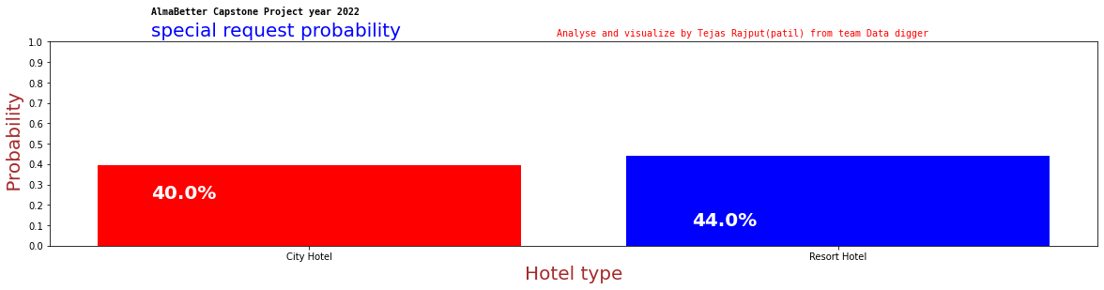
CONCLUSION
As you can see red bar is indicating probability in percentage of getting special request to city hotel and blue is indicating probability in percentage of getting special request to Resort hotel.
Resort Hotel is more Likely to get special request than City Hotel

Slide 16
5.Customer From Which Nationalities Visits The Hotel Most ?
Sometimes we need to find people from which country visits hotel the most.
We can find this by grouping the data and then sorting them according.
Using this data we can conclude hiring staff which knows Portuguese better would always benefits APA group new hotel , and using this data they can also run profitable ad campaigns APA group new hotel , and using this data they can also run profitable ad campaigns.

Slide 17
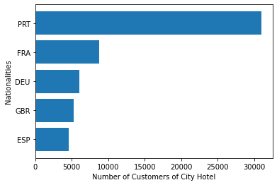
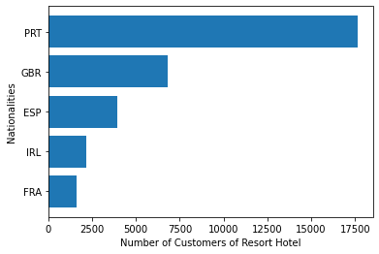

Slide 18
Top Five most Visited nationalities
Top Five most Visited nationalities in city hotel in
Descending order are:
1)PRT =PORTUGAL
2)FRA = FRANCE
3)DEU = GERMANY
4)GBR = UNITED KINGDOM
5)ESP = SPAIN
Top Five most Visited nationalities in Resort hotel
in Descending order are:
1)PRT =PORTUGAL
2)GBR = UNITED KINGDOM
3)ESP = SPAIN
4)IRL=IRELAND
5)FRA = FRANCE
Conclusion
As you can see from above graphs and tables Portugal customers are dominating in both types of hotel ,so we can conclude hiring staff which knows Portuguese better would always benefits APA group new hotel , and using this data they can also run profitable ad campaigns

Slide 19
6.How Many Days Customers Prefer TO Stay The Most?
Sometimes hotel staffs would need to find how many days customers Want to stay in the hotel.
This data can be helpful to make new booking offers and holiday packages based on customers preferences.
We will find this data using different algorithms.

Slide 20
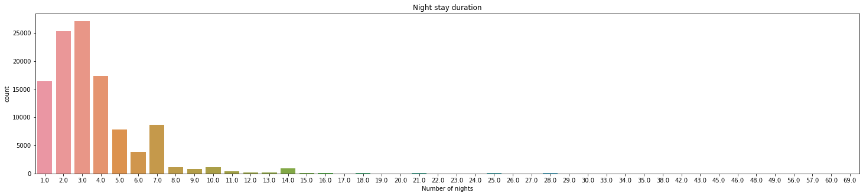
From the graph we see that most of the customers like to stay for 3 days followed by 2 days.
Conclusion

Slide 21
7.What is the rate of cancellation in city hotel and resort hotel?
Having the data for the booking and cancellation rate of hotel types can be very helpful for one to find which hotel provides better services and eventually to decide which hotel to choose for booking.
From the dataset we find the booking and cancellation rate in both resorts and city hotel. Then we find which hotel type has higher cancellation rate.

Slide 22
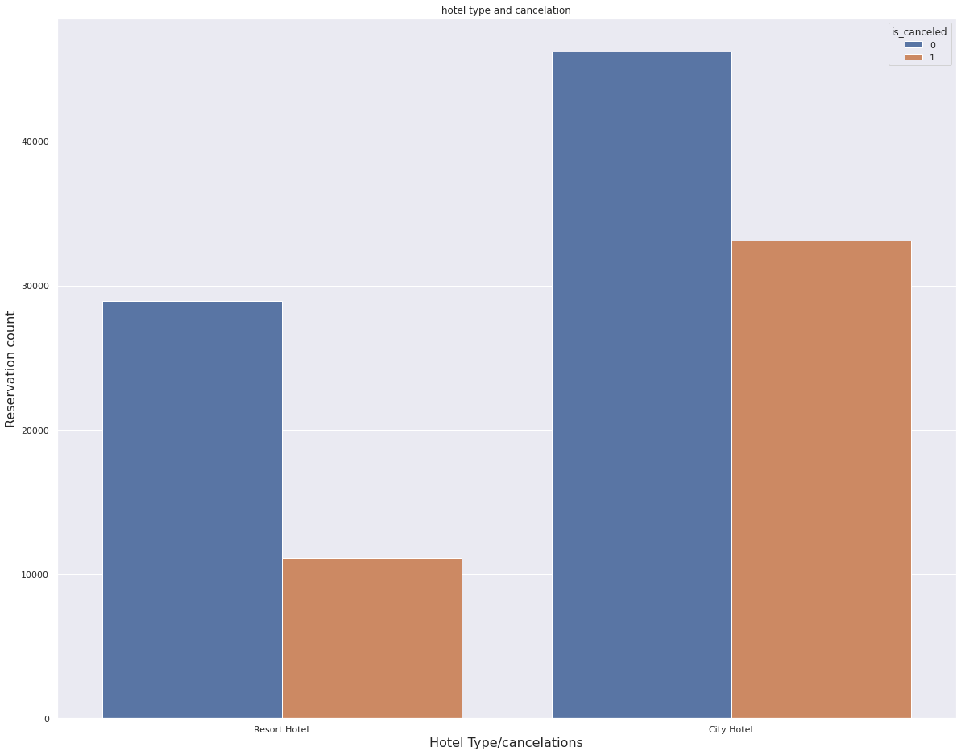
Thus we can conclude from above Observation that 37% customer were cancelling booking of city or resort hotels
Conclusion

Slide 23
8.Time Series Analysis on most lucrative market segment Online TA
Time series analysis for hotel booking can be very helpful for hotel and business owners to understand the market.
This will be helpful to understand market demand for hotels throughout the year.

Slide 24
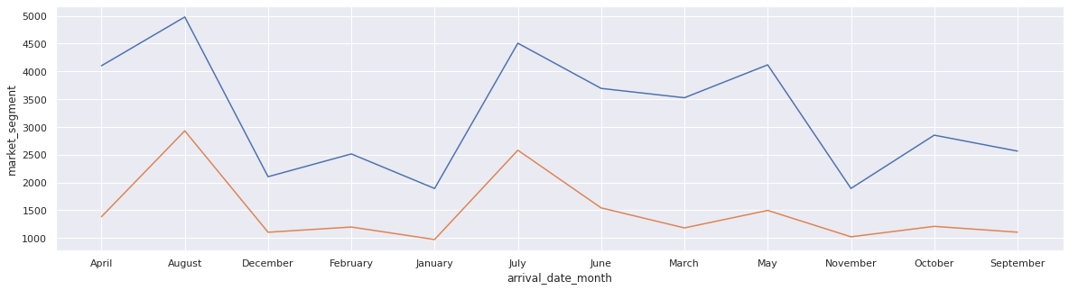
We can clearly see from above graph that there is seasonal variation in hotel bookings both hotel is following same trend but with different numbers ,August is most visited month and January is least visited in both types of hotel.
Conclusion

Slide 25
9.How Many customers require car parking spaces
For hotel management it is very important to understand demands of their customer. Car parking facility is one of those demands.
From the data we will find how many customers would like to have parking facility in hotel.
This data will help hotel management to improve their services and business.

Slide 26
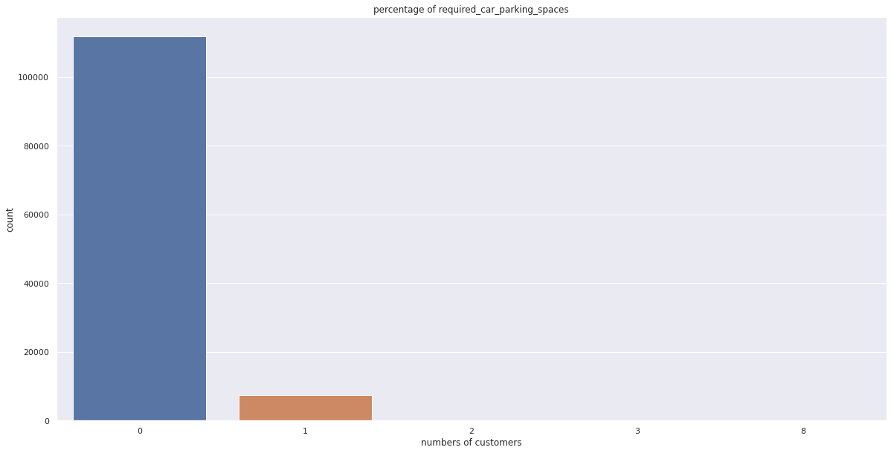
Number of customers who require car parking spaces

Slide 27
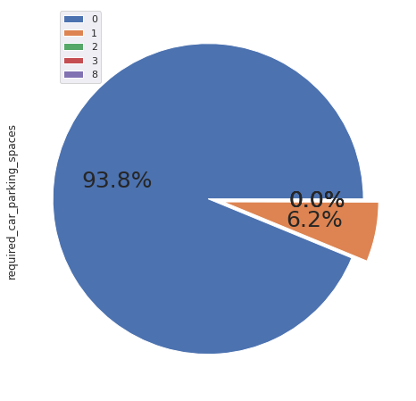
Conclusion
From above graph and pie chart we can observe 93% customers require car parking space

Slide 28
10.What type of meal customers prefer to have in hotel
From the data we will find what is the most preferred meal type by the customer booking the hotel.
This data will help hotel management to understand customer needs and improve their services.
An excellent customer service will improve the relationship between their guests and their establishment.
Also, satisfied guests are more likely to come back and be loyal to the hotel, as they will become true brand ambassadors.

Slide 29
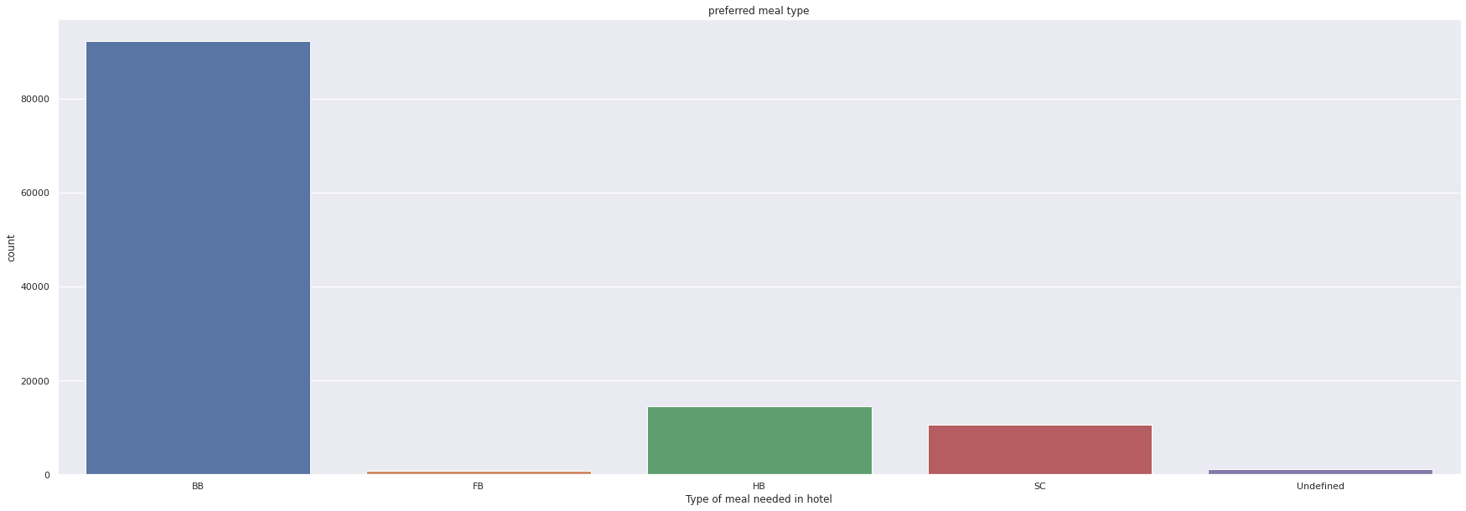
Number of customers preferring different types of meals

Slide 30
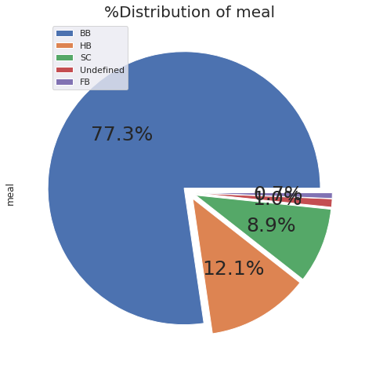
Conclusion
Observed here that Highly preferable meal type is BB(bed and breakfast) which is required 77.3% and second most is HB(half board) which is required 12.1%

Slide 31
11. Predicting whether or not a hotel was likely to receive a disproportionately high number of special requests?
From the data we will find how many special request are made by the customers.
Then we will find how many of these request were received for city hotel and resort hotel.
We will then find out number of requests received for different months.

Slide 32
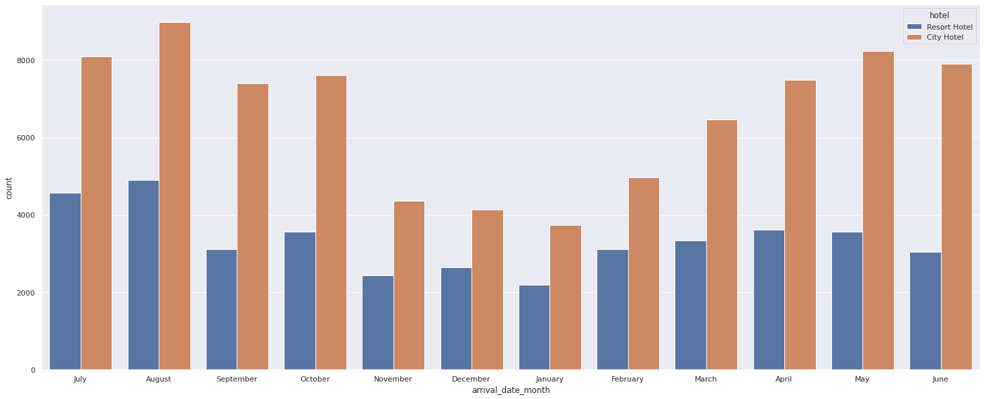
Conclusion: Both city hotel and resort hotel receive most number of requests in the month of August

Slide 33
12. How Many Guests Are Repeated
Predicting which customers are coming back to book hotels again can be very helpful for the hotel management from business point of view.
This data will be very helpful in retargeting customer base for the marketing campaigns and building a strong customer base.

Slide 34
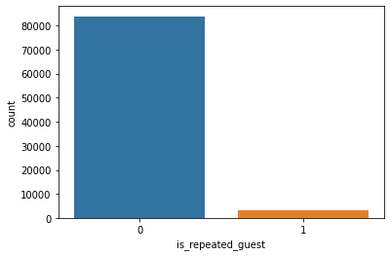
Conclusion: Out of total 87230 customers,83866 are repeated and 3364 are not repeated

Slide 35
13.Hotel Demand By Market Segment
Its very important for hotel management to understand from which market segment does the hotels have more or less demand.
This data will help hotel businesses to set their market price based on the increasing or decreasing demand.

Slide 36
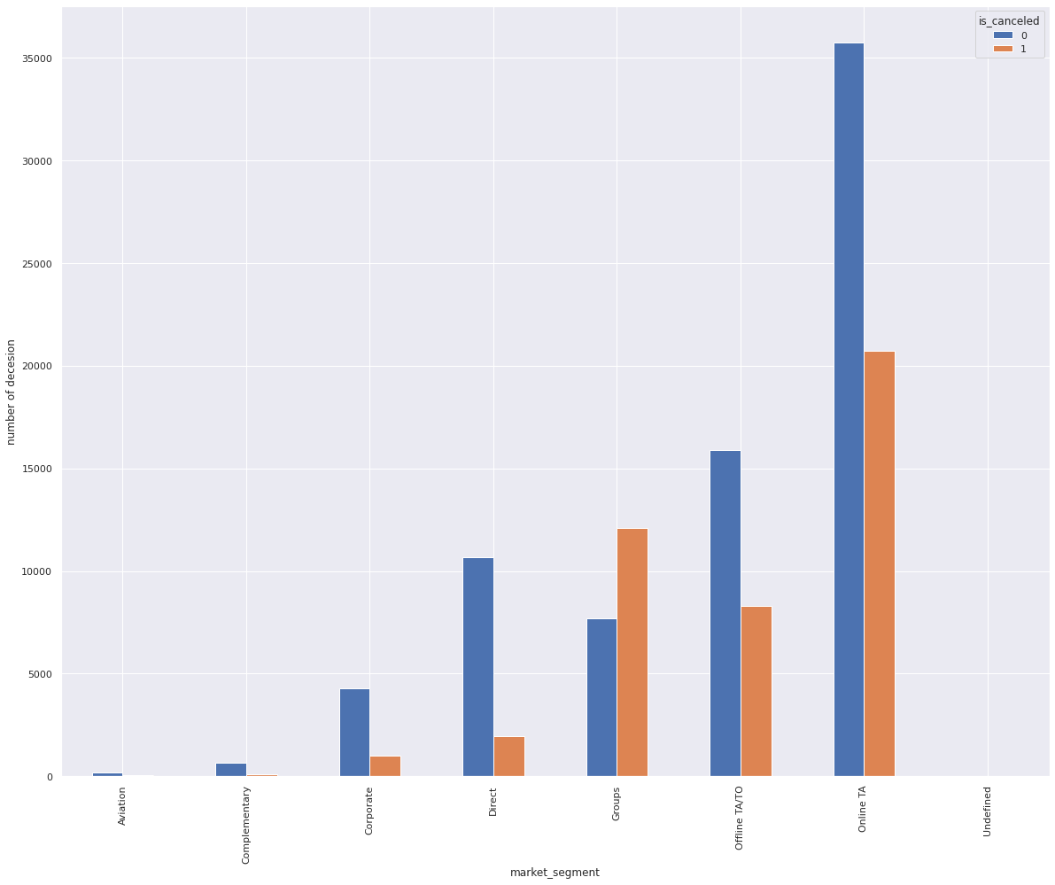
Conclusion: Both City Hotel and Resort hotel is in demand among customers belonging to market segment of online TA

Slide 37
14:Number of arrivals every day of the month and year
Having the data of year wise arrival of customers and bookings made by them is very important for hotel businesses.
Analysis of this data will help hotel businesses to understand how the market is growing every year.

Slide 38
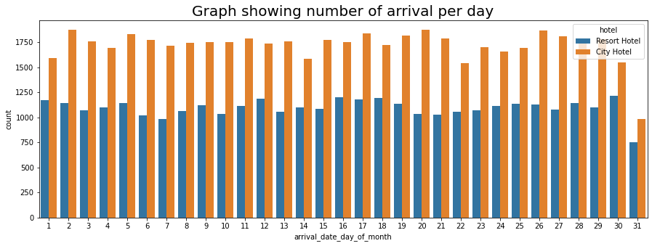

Slide 39
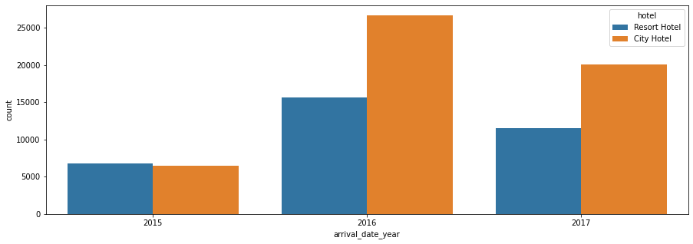
Conclusion:From the graph we can say in year 2015 number of arrivals were same but in 2016 city hotel has more arrivals than the resort hotel and same trend is followed in the year 2017 as well.

Slide 40
15: Total Bookings Canceled in every months of the year
Having the data of month wise hotel booking cancellations is important for hotel management.
This data can help hotel management to understand why the cancellations occurred in the particular month and hence they can improve their service for the future.

Slide 41
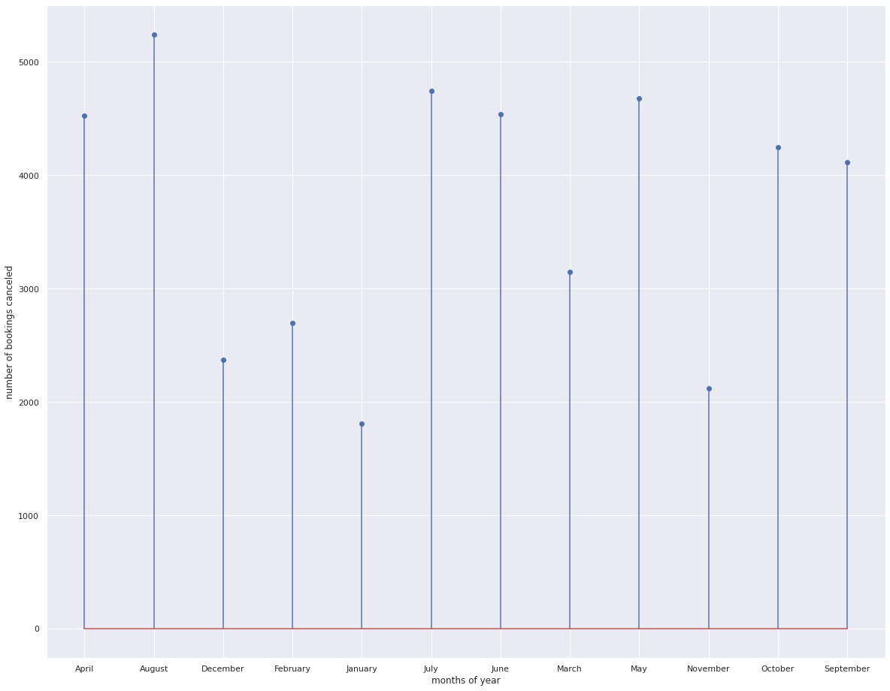
Conclusion: From the graph month of August faced most cancellation of bookings and month in of January customers canceled bookings least

Slide 42
16:Co-relation of the column
Co-relation is measure of strength of relation between two variables like, if there is positive co-relation between two variable then the are strongly co-related for example if demand is increasing supply is increasing ,and negative co-relation specify just vice versa.

Slide 43
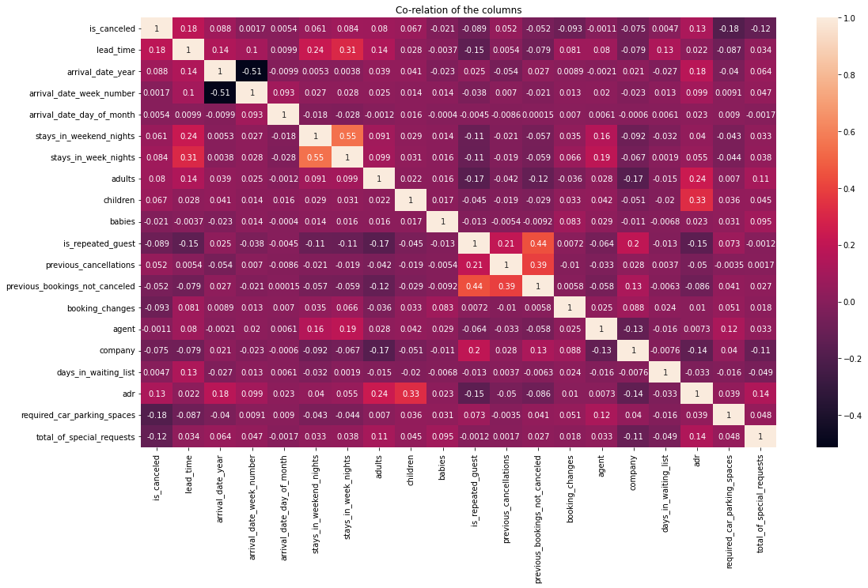
Conclusion: In the above co-relation matrix we have co-relation between different columns of Data Frame and we can compare the two columns based on their annoted values take "is_cancled" and "lead_time' column for example you can there is positive c-orelation between these two columns but not very large

Slide 44
THANK YOU

